Slide 1
Out-of-Pocket Costs Following Abnormal Prostate Cancer Screening
Arnav Srivastava

Slide 2
Prostate Cancer Screening
~ 300,000 cases yearly
Most patients are diagnosed by PSA-screening
PSA testing, when done appropriately, reduces prostate cancer mortality and saves lives

Slide 3
Biopsy
MRI
55 – 69 years old
Private insurance
PSA Blood Test

Slide 4
How we studied out-of-pocket costs
Privately insured patients
MarketScan database
Men ages 55 – 69
2010 – 2020
Out-of-pocket costs related to prostate cancer testing within twelve months

Slide 5
Typical Screening Pathway
1. Biopsy
PSA
PSA
3. MRI & Biopsy
2. MRI

Slide 6
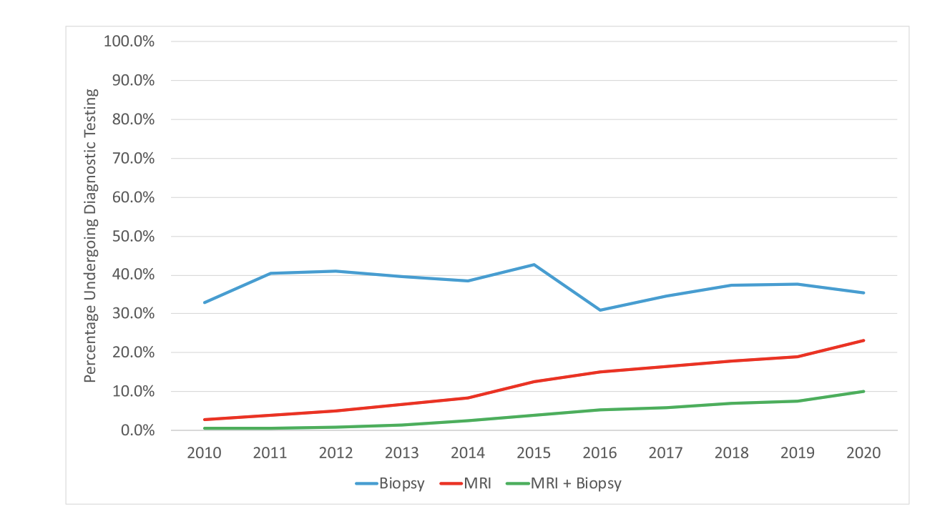

Slide 7
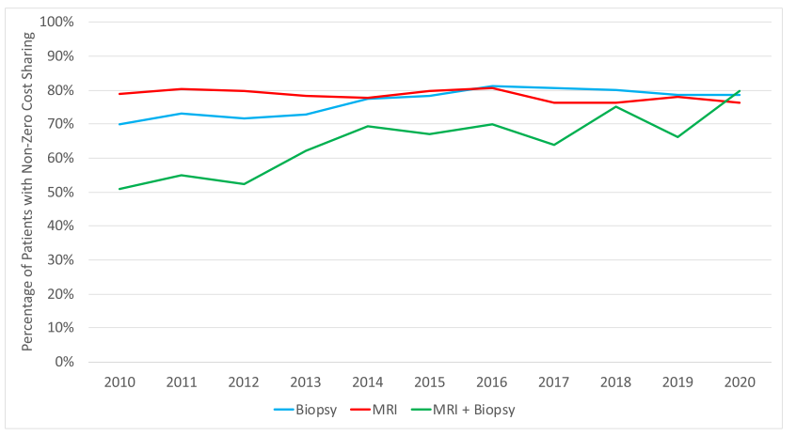
Non-Zero Cost Sharing
Srivastava et al. Cancer, 2024

Slide 8
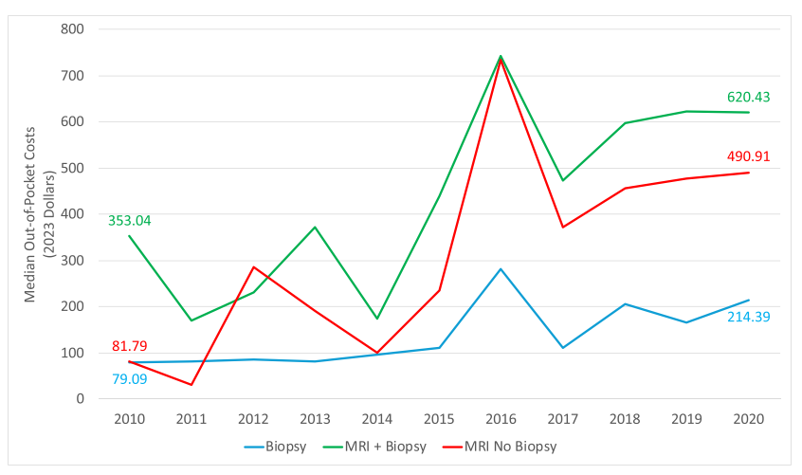

Slide 9
Srivastava et al

Slide 10
Implications
Financial Toxicity
Delayed Care
Forgone Care

Slide 11
Lessons from Colorectal Cancer
Prior gap in coverage colonoscopy after non-invasive screening test
Affordable Care Act

Slide 12
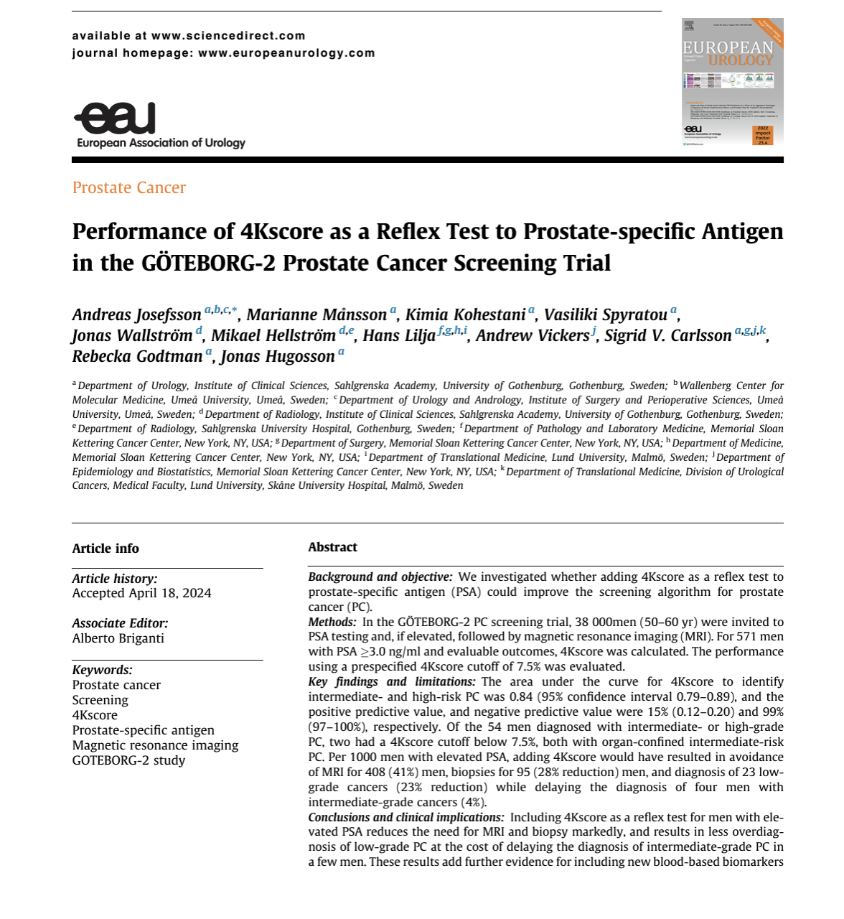
Solutions
Policy
Insurance Design
Screening science
Biomarkers

Slide 13
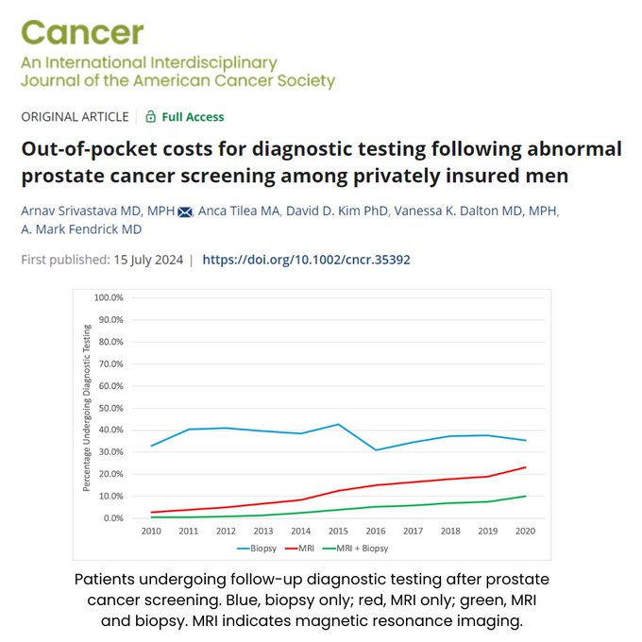
Conclusions
Out-of-pocket costs for diagnostic testing after abnormal screening
Common
Substantial
Rising
Burdens for those most likely to benefit
Screening is a continuum of testing

Slide 14
Team

Slide 15
Research Mentors

